Slide 1
ENED1120: Foundations of Engineering Design Thinking II
Day 11.2
Conditional Flow in Visual Basic for Applications

Slide 2

Outline
Announcements
RAT 11.1
VBA Conditional Flow
  Review of basic syntax
  Example
  Activity
CFU 11.1
Work on Projects

Slide 3
Announcements
See Canvas
  https://uc.instructure.com/courses/1744110/discussion_topics/9731890

Slide 4




Slide 5
Syntax Summary
Conditional Statements:
Relational operators:
> greater than
< less than
>= greater than or equal to
<= less than or equal to
= equal to
<> not equal to
Logical operators:
And, Or, Not
If Structure:
If condition Then
code
ElseIf condition Then
code
⁞
Else
code
End If

Slide 6
Example
Create a macro in Excel that will
take a temperature along with the
original and desired units and
covert the temperature from
one system of units to the other
You can do this problem using Excel formulas and would end up with something like this:
=IF(C3="F",IF(D3="C",(5/9)*(B3-32),(5/9)*(B3-32)+273.15),IF(C3="C",IF(D3="F",(9/5)*B3+32,B3+273.15),IF(D3="C",B3-273.15,(9/5)*(B3-273.15)+32)))
Original | Desired | Conversion
ºF | ºC | T_{C} = (5/9)*(T_{F} – 32)
ºC | ºF | T_{F} = (9/5)*T_{C} + 32
ºF | K | T_{K} = (5/9)*(T_{F} – 32) + 273.15
ºC | K | T_{K} = T_{C} + 273.15
K | ºF | T_{F} = (9/5)*(T_{K} – 273.15) + 32
K | ºC | T_{C} = T_{K} – 273.15

Slide 7



Do not edit
How to change the design
What data type should the units be taken in as?
The Slido app must be installed on every computer you’re presenting from

Slide 8
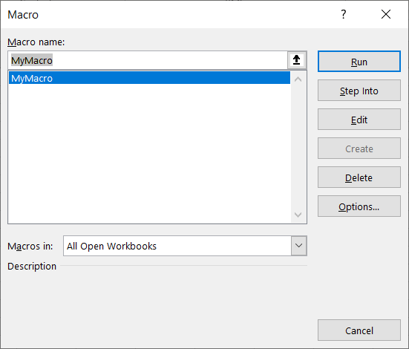
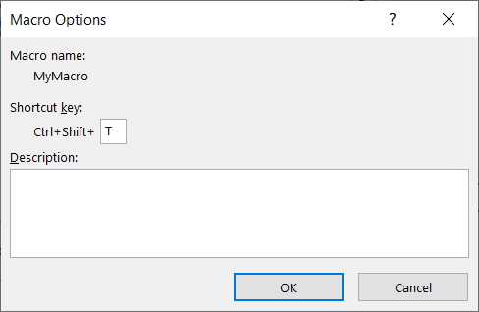
Example
A few helpful commands:
ActiveCell – refers to the currently selected cell in the worksheet
ActiveCell.Offset(r,c) – refers to a cell r rows and c columns away from the currently selected cell
You can assign a shortcut to a
macro from the macro window

Slide 9
Do not edit
How to change the design
If I'm currently on Cell 3E, which cell will ActiveCell.Offset(0, -3) point to?
The Slido app must be installed on every computer you’re presenting from

Slide 10

Example
Take 5 minutes silently to write/type out how you would build this conditional decision tree. This can (should) be pseudocode.
Then, compare your answer with your neighbor’s answer for the next 5 minutes. Discuss:
  What did you all do similarly?
  What did you all do differently?
  Which aspects of your partner’s solution
  would you use in your solution the next
  time you see a similar problem?

